Slide 1
Tracking the Tribe
How do you get around a wall
when you can’t find the door?
By Sigrid Pohl Perry
perry1121@aol.com
S.G.G.E.E.
11 August 2013

Slide 2
Do you have. . .
An old album filled with unlabeled photographs?
Grandparents with no dates, places or families attached to them?
Relatives who just materialized in the New World or came from villages you can’t find?
Conflicting information about dates and places for ancestors?
What do you do next?

Slide 3
Track the Tribe: Find your Clan & Ancestors
People travelled and settled in groups with ties
Related families from the same village may have immigrated to a new place together
Look for immigration clusters on ship manifests and in early census records
Compare census records & track the immigration of neighbors. Are they from the same village?
Examine the witnesses on documents and figure out how they might be related to your family
A clan member’s record may lead you to your own ancestral village & your missing relatives

Slide 4
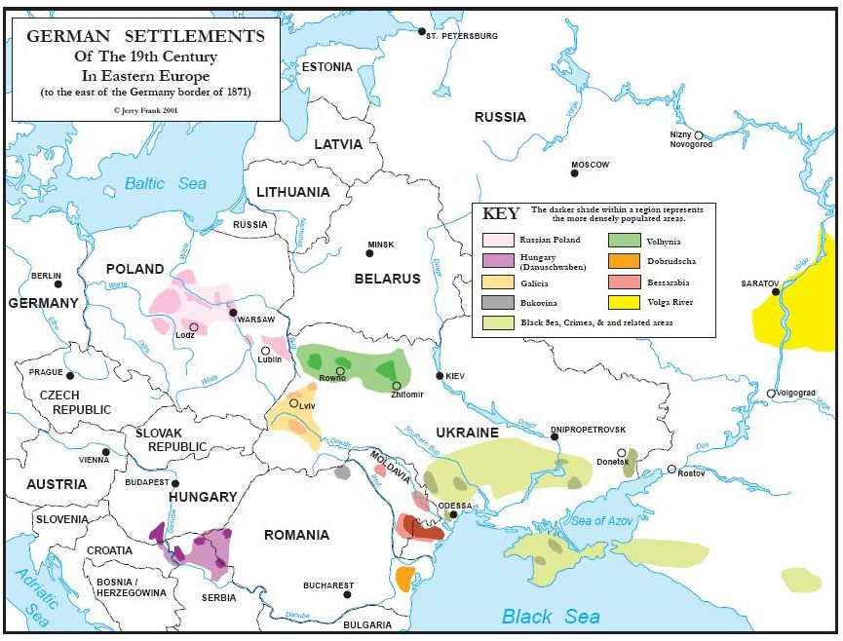
Notes:
Emigration, Deportation in WWI, return emigration, Umsiedlung in WWII, Flucht, Emigration, Reunification

Slide 5
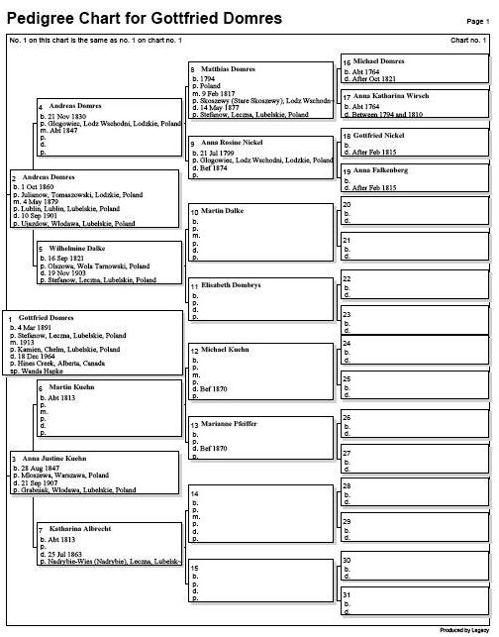
Notes:
WWII era document with German pedigree: column one with hints from column two

Slide 6
Domres Dumries Domroes Domrose Dombrys Domras Domreis Dąbrys
U.S. census records show few families 1900-1920
Volhynia (Ukraine) or Russian Poland origins in Oconto County, Wisconsin; Saginaw, Michigan; Cavalier, North Dakota
There are a few SGGEE German members with Domres roots in Cycow near Lublin about 1870
EWZ revealed some with Lublin area & Volhynia roots
EWZ revealed some with Lublin roots in Latvia
Saskatchewan and Manitoba

Slide 7
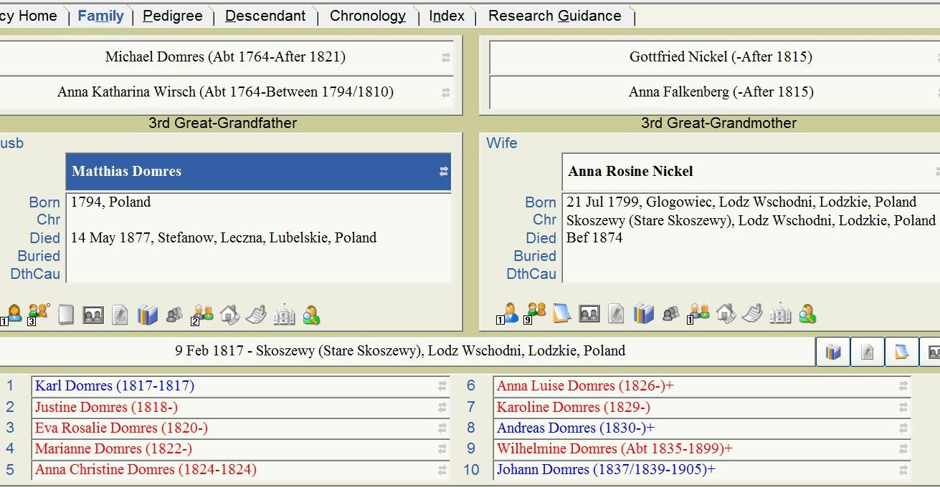
Notes:
Marriages in 1874 and 1875 for Johann Domres (2nd marriage) and Anna Luise Domres pointed to Glogowiec and linked Sandor Krause as my 4th cousin once removed. Film from Stare Skoszewy Catholic church before 1830 when Brzeziny Lutheran began; no known records for Brzeziny at this time: Domres gap from 1830- Lublin records ca1862. Collaborated on Latin and Polish records!

Slide 8
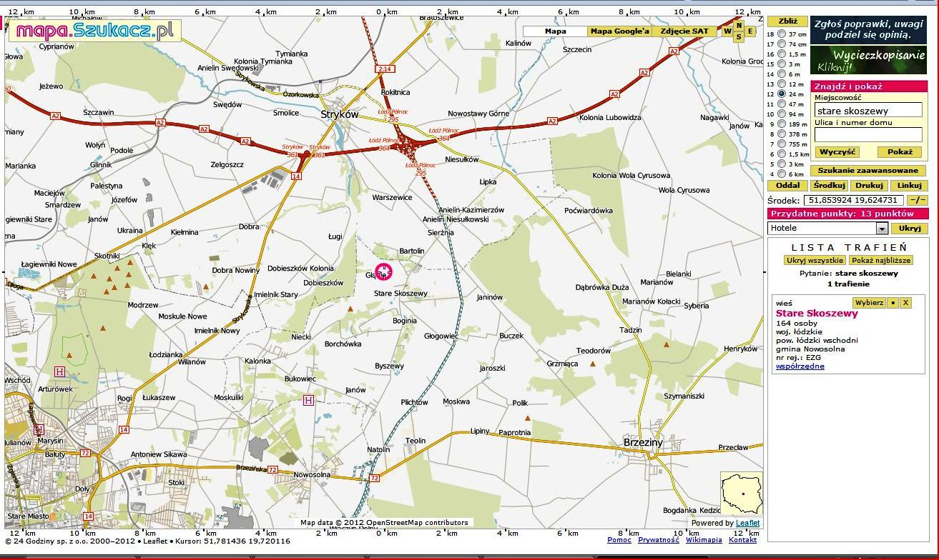
Glogowiec 1790s – ca1840

Slide 9
Glogowiec area names in Lublin 1834-1940
Belke
Bilof/Buelow
Domres
Falkenberg
Fitz
Freund
Fruk
Grossmann
Hirsekorn
Klatt
Klukas
Krentz
Krueger
Lenz
Milbra(n)dt
Missal
Nickel
Reske/Riske
Riewe
Rosentreter
Schindel
Schmidt/ke
Schulz
Taron
Wolski
Notes:
Found more than Domres! Records were in Polish and Latin including “translations” of names into those languages. In Glogowiec from before 1800!

Slide 10
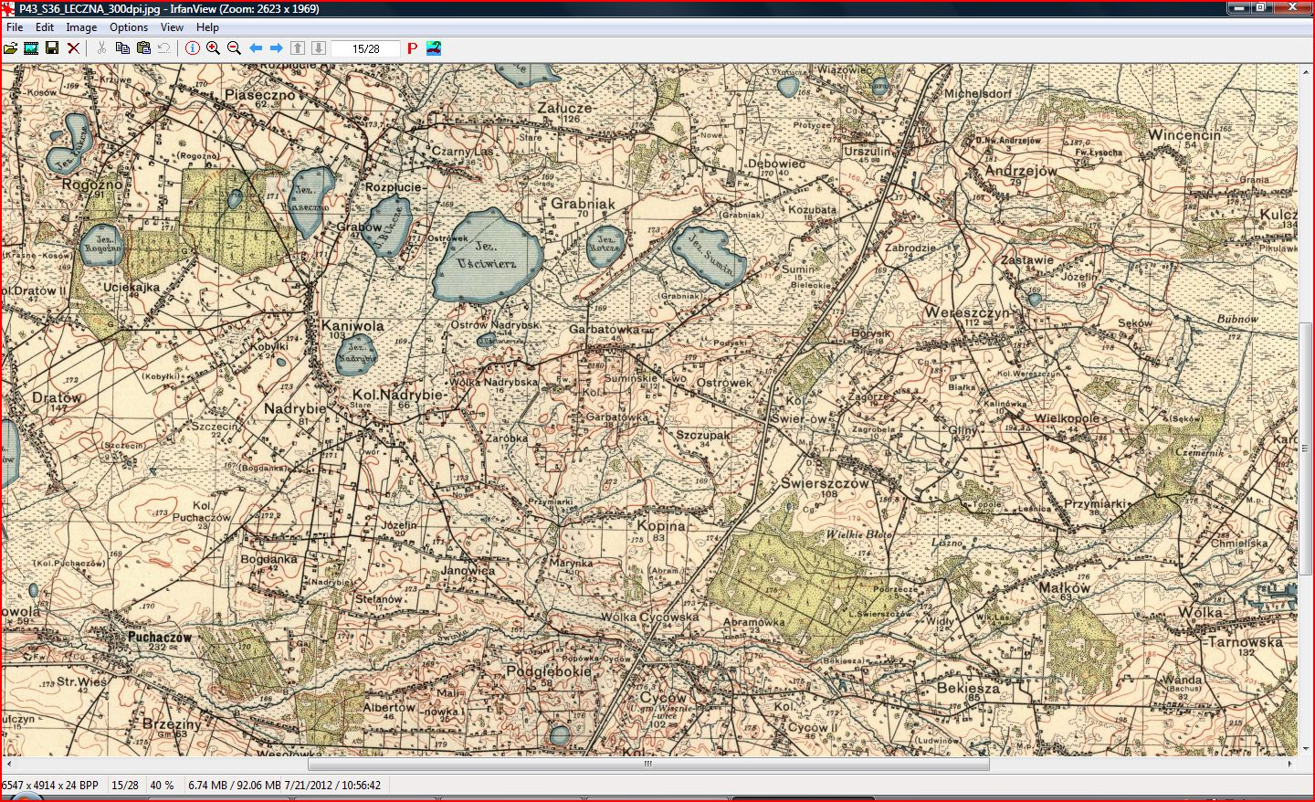
Notes:
Michelsdorf near Urszulin, Debowiec, Zalucze, Stefanow, Bogdanka, Cycow, Nadrybie, Rozplucie

Slide 11
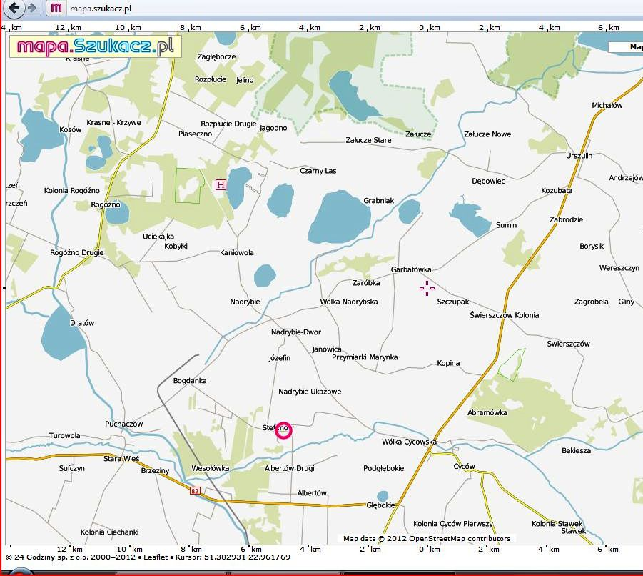
Leaving Russian Poland
Notes:
Domres/Lueck family to Oconto County, Wisconsin in 1898. Domres/Krentz to Mogilno, Poznan area ca1901/1909. Radke/Domres family to Mogilno, Poznan area ca1904/1909 with other family following. Ludwig Domres to Latvia ca1915-1920; resettled in 1940.

Slide 12
SGGEE Emigrants in the MPD
Deaths | Poland births | Ukraine births
Wisconsin | 184 | 139
Oconto County | 37 | 3
Milwaukee | 40 | 21
Michigan | 308 | 309
Berrien County | 52 | 160
Illinois | 210 | 37
Chicago | 120 | 18
N. & S. Dakota | 90 | 199
Washington | 61 | 103
Oregon | 60 | 76
California | 71 | 104
Alberta | 396 | 510
Edmonton | 138 | 141
British Columbia | 172 | 216

Slide 13
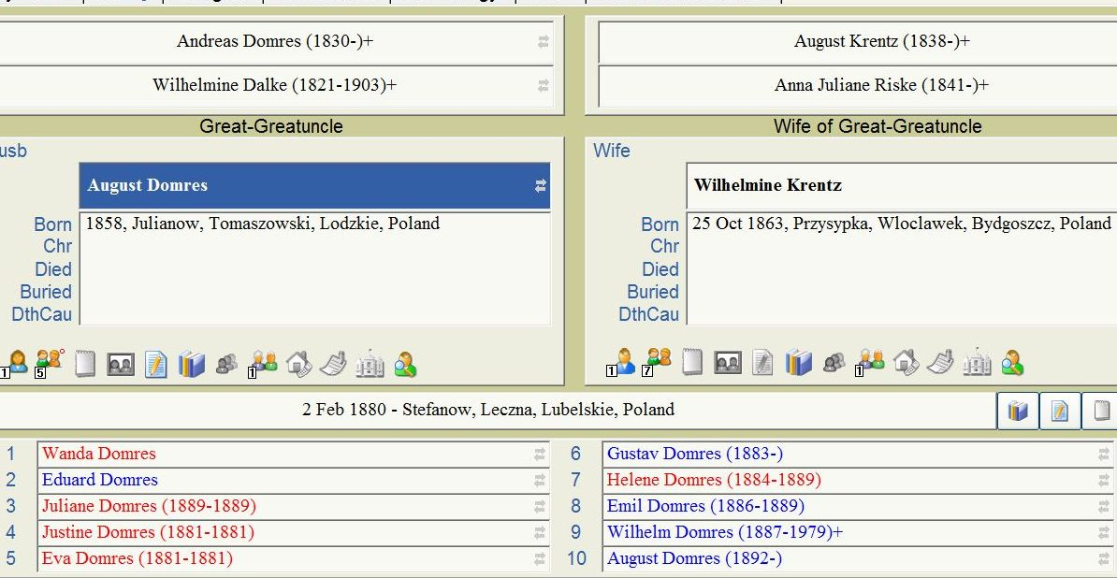
Notes:
At least 17 children (only 3 daughters); family story is that they had 24—with only one daughter who lived! ; EWZ supplementary information on Opa Gottfried Domres revealed he’d lived with this uncle from 1909-1911 [his father died in construction accident in 1901 and his mother died in 1907]; my mother was also born in this region in 1922 when he returned there with his family after the WWI Deportation years and needed to find work to support them between 1920-1923, then returning to the Lublin area.

Slide 14
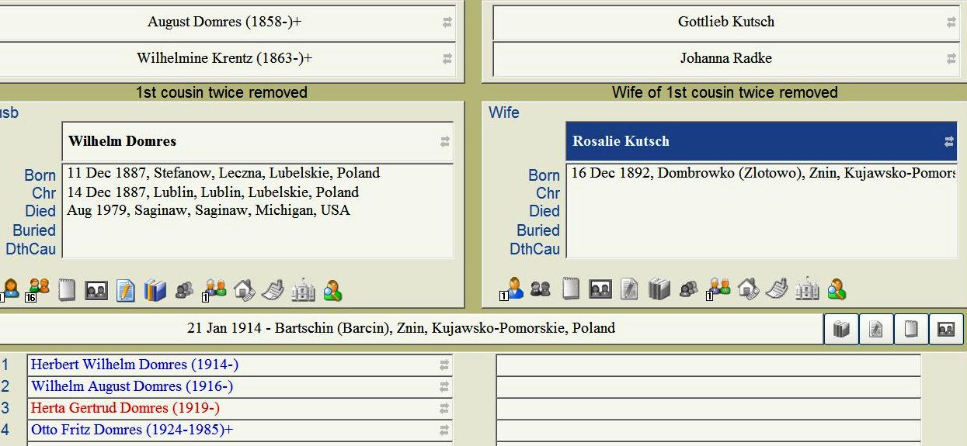
Notes:
Cousin Patti Domres Horetski near Columbus, Ohio; tribal enclaves in Saginaw and Berrien counties, especially near Benton Harbor and Wolf Creek. They moved from the Posen area to Schleswig-Holstein by 1924 because her father was born there. So, did the entire family move then? But my grandfather returned to Lublin.

Slide 15
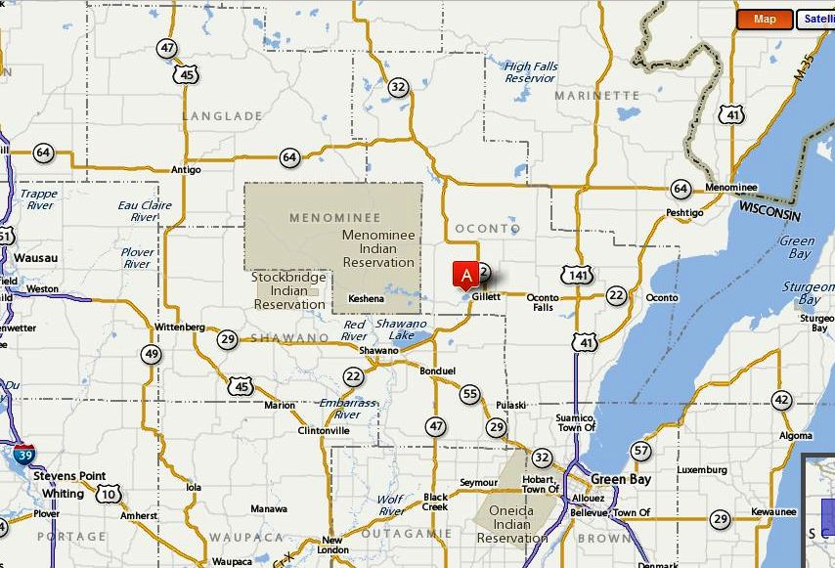
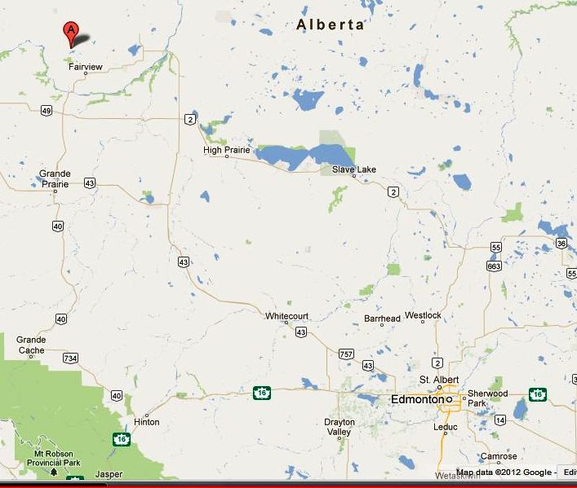
North American Immigration: peak years
Alberta, Canada
1928-1937; 1950-1952
Oconto County, Wisconsin 1898-1913
Notes:
Homesteading years; refugee years. Hines Creek, Alberta: Zabel/Hapke in 1929; Domres in 1950. Edmonton: Zabel, Klingbeil et al.

Slide 16
Families in Hines Creek, Alberta who emigrated from the Lublin area 1928-1950
Belke/Matthews
Boelke/Schultz
Brauer/Klatt
Brauer/Sterk
Dei/Schultz
Domres/Hapke
Janke/Fruk
Kaut
Kipke/Bak
Kitzmann/Kotke
Klatt/Steinke
Krahn/Wolski
Lemke
Riemer/Splett
Riewe/Fruk
Schultz/Schuh
Schultz/Reichwald
Will/Neumann
Wolski/Kaut
Wolski/Schultz
Zabel/Hapke
Notes:
Some families left Hines Creek to seek work other than homesteading. They settled as close as Edmonton or as far away as Vancouver or other Canadian cities.

Slide 17
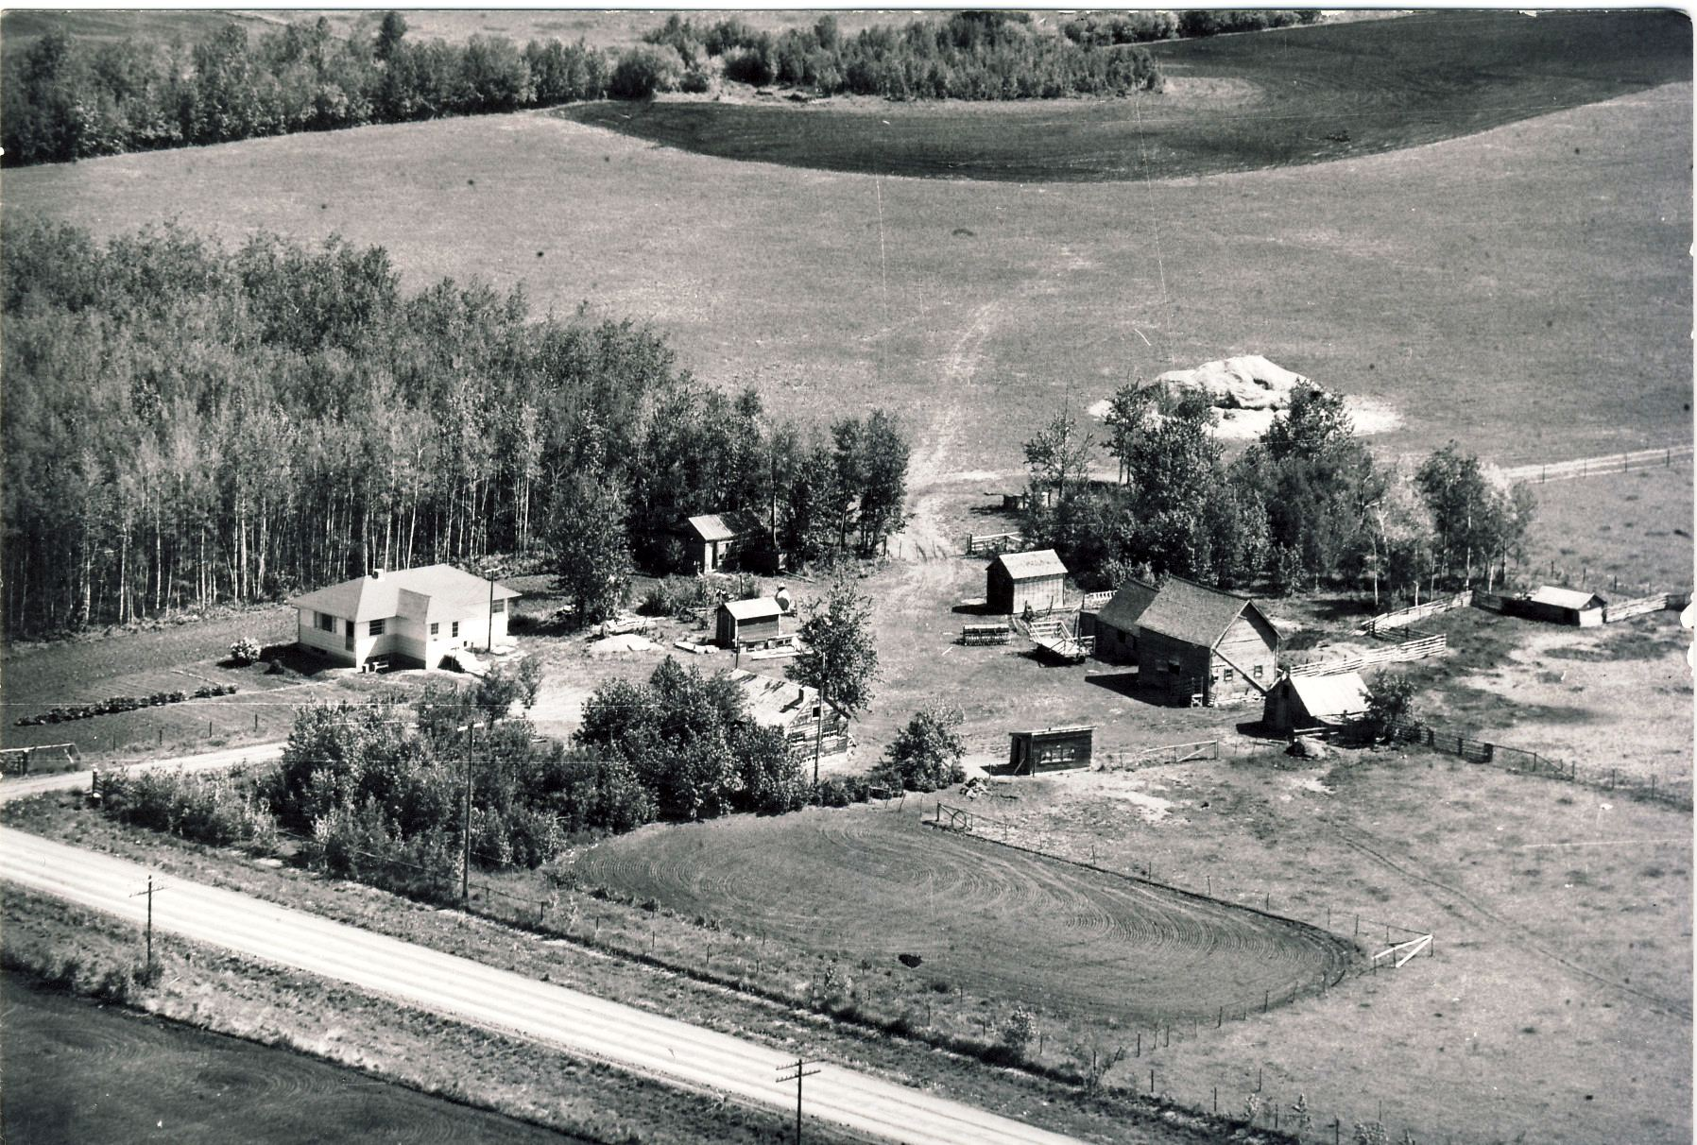
Farm south of Edmonton belonged to Robert Wendland whose sister married my Pohl grandfather’s nephew, Gottfried Klukas.

Slide 18
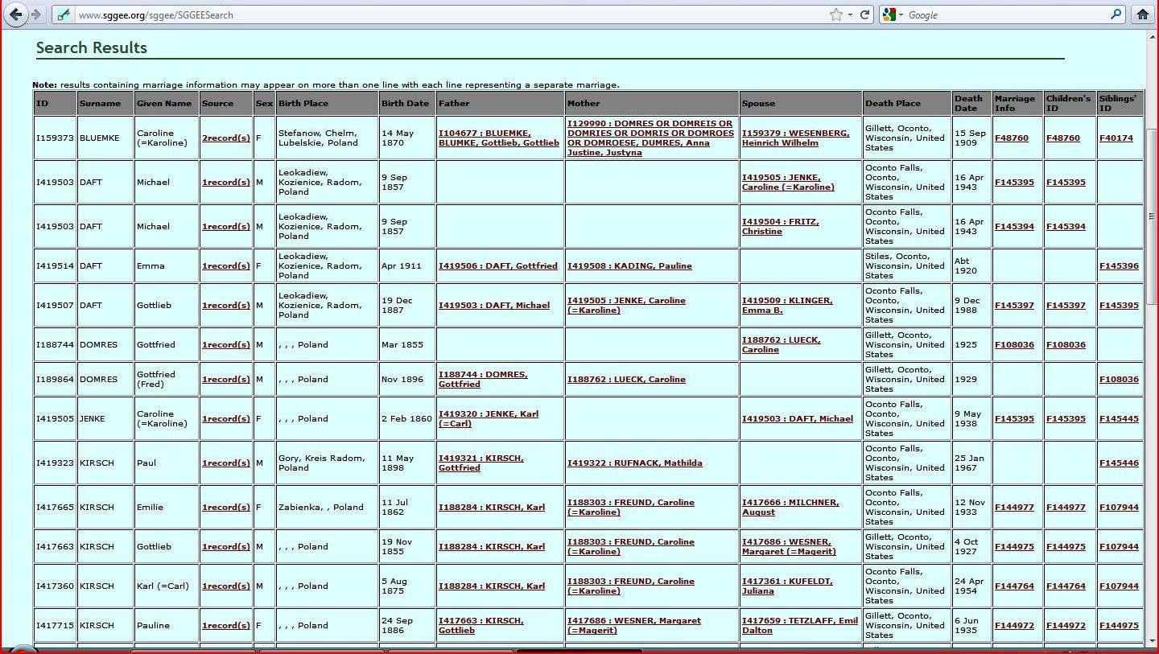
MPD search: Poland & Oconto
Notes:
Do other members have similar migration history? Not necessarily blood relatives.

Slide 19
SGGEE members linked to
Oconto County, Wisconsin
B005
B017
B089
B099
G034
H051
K054
L038
M008
M110
P020
S056
S067
S075
S116
S132
S169
T012
Notes:
Census Project: districts in Oconto County and specific wards in Milwaukee who had German immigrants from Russian Poland. So far, we have included 180 census pages, enumerating over 1,000 individuals from 1900 and 1910 census.

Slide 20
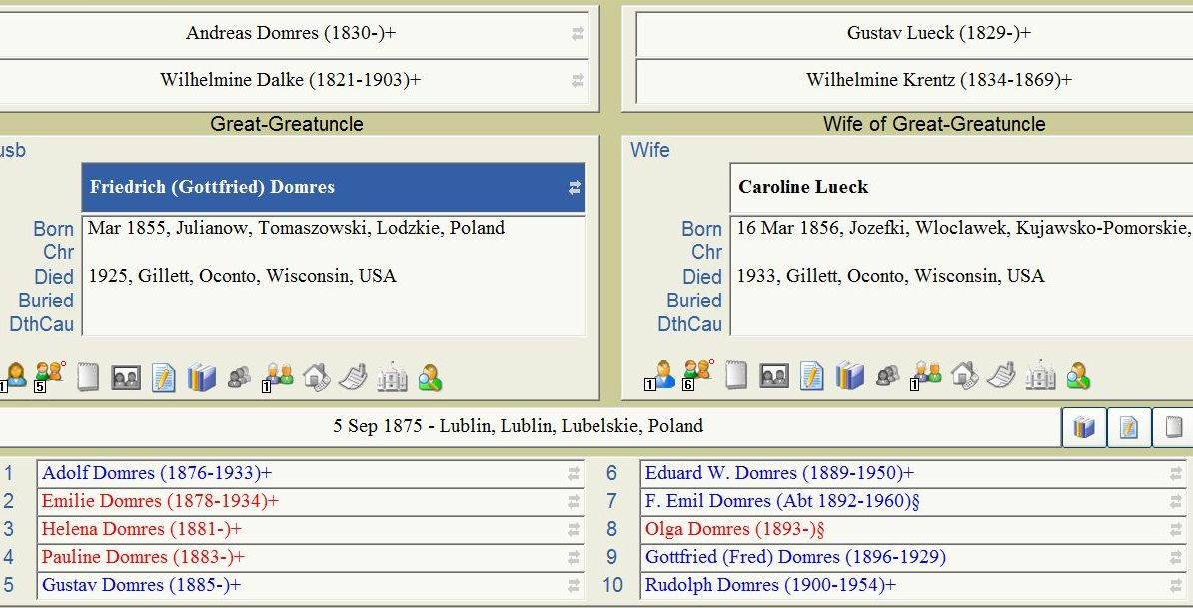
Notes:
Daughter Emilie

Slide 21
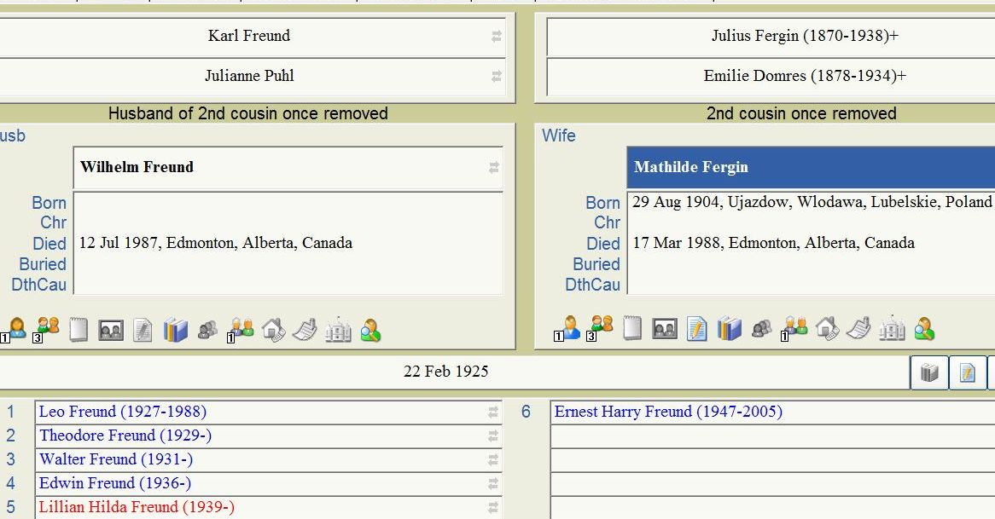
Notes:
Met Marie Swanson at the 2010 convention; her husband is a descendent of Walter Freund and thus a Domres cousin; they live in Northwest Territories. Leo Freund was born in Poland, Theodore & the others were born in Alberta, so they were part of the wave of immigration ca 1928.

Slide 22
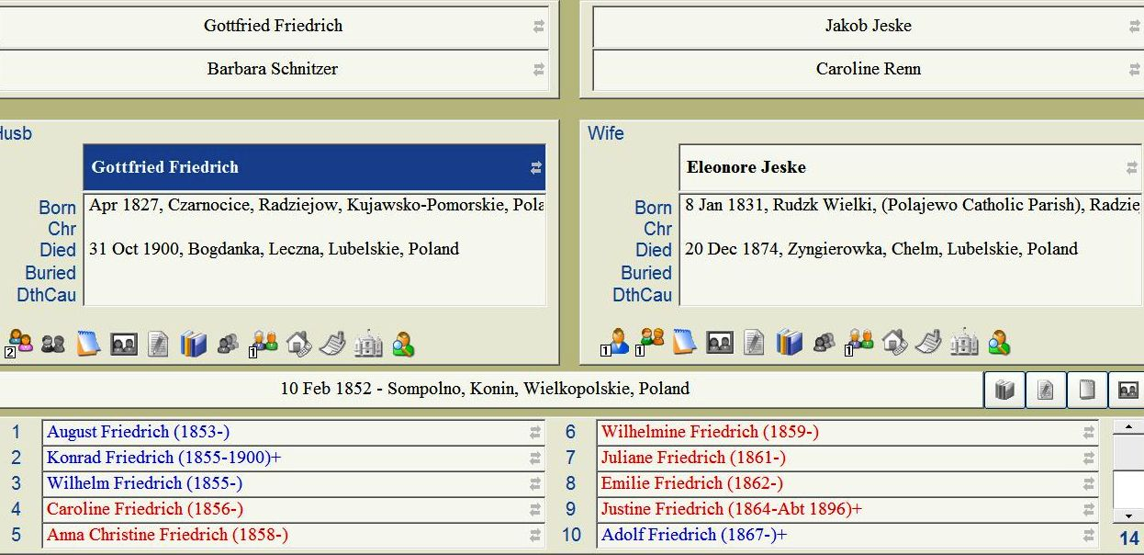
Descendants of this family immigrate to Volhynia, Germany, Wisconsin, Illinois & Canada; at last count about 10 SGGEE members connect to these ancestors (not all yet in MPD)

Slide 23
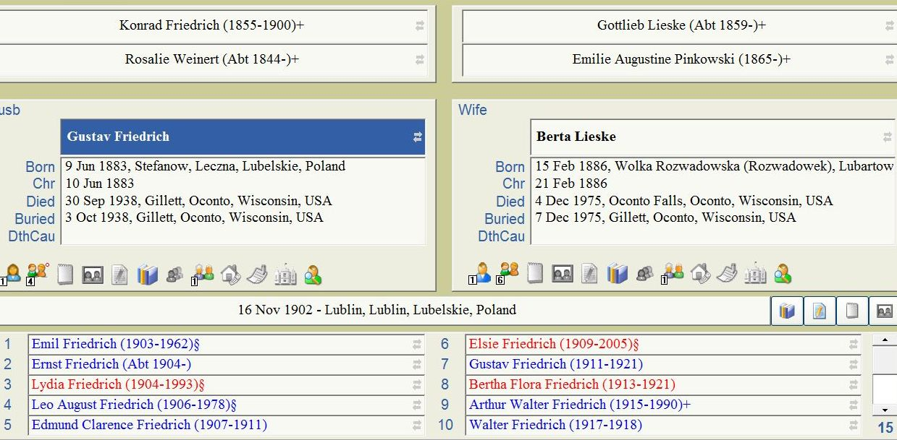
Notes:
Gustav’s brother Adolf married Pauline Domres in Oconto County. Other SGGEE member surnames married to this family include Zelmer and Hauf.

Slide 24
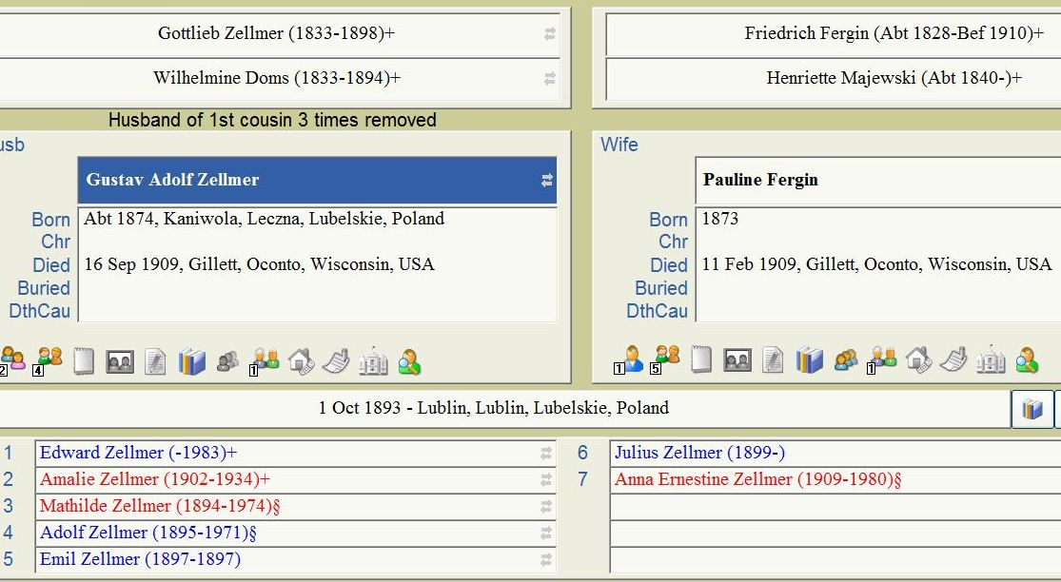
Notes:
Family related to the Domres/Fergin family in NWT and to the Friedrich and Domres families in Gillett.

Slide 25
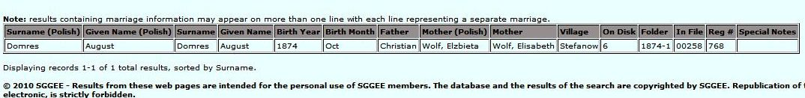
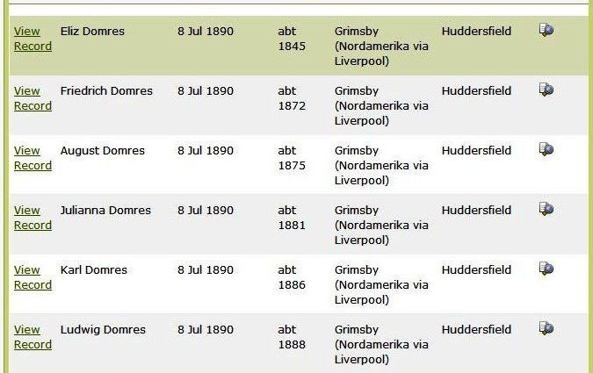
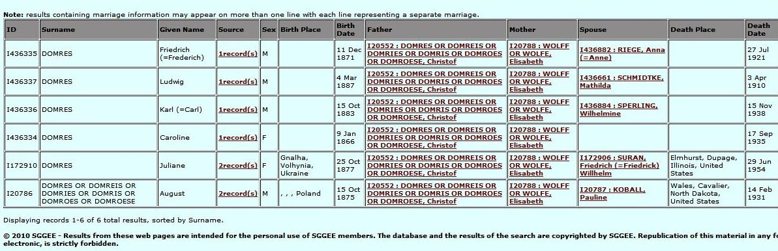
Another cousin?
Domres from Poland to Volhynia and then to North Dakota
Birth of August Domres in Stefanow on 17 Oct 1874. Christian (aka Christof) is 35 [1840]. Elisabeth is 30 [1844]. Godparents at baptism on 18 Oct are Gottlieb Schachtschneider, Johann Nickel, & Mrs. Juliana Klapstein
Notes:
Not yet able to connect this family in the MPD who immigrate from Volhynia to ND to my Domres tribe but this can’t be coincidence! Johann Nickel’s eldest daughter marries my great-great-uncle, Christian Domres. And the Nickel family is prominent in the Glogowiec data, including an earlier Johann; my ancestor in Anna Rosine Nickel.

Slide 26
Find the Clan’s trail of immigration
Check ship manifests for relatives at the destination and names of those left behind in Poland or Volhynia
Look for the people in the destination town or county in census records; see when they immigrated and look for information on that ship manifest
Look in the SGGEE databanks (MPD, St. Petersburg, PRI); use Soundex
Lublin Project: search births, deaths, marriages separately; use Soundex
For any US or Canada searches, be creative about spelling and searching; don’t rely on the indexers—they don’t know your Tribe! Compare data on various records!
Notes:
Now for some examples!

Slide 27
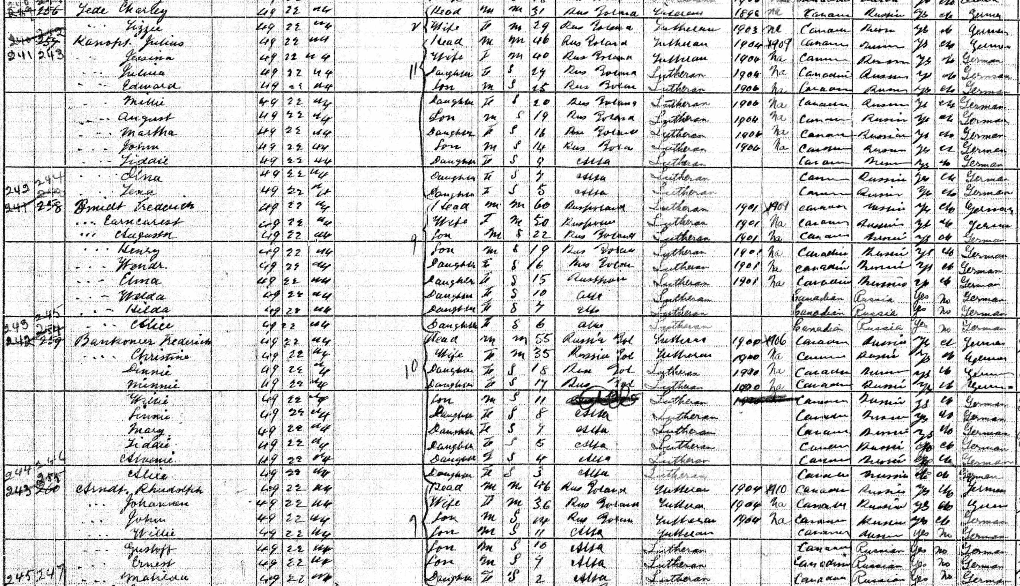
Strathcona, Alberta 1916
Notes:
Take a look at the Kanopt family: what kind of a name is that! Pronounce it in German Knop or Knob. Notice the Rudolph and Johanna Arndt family are neighbors. All are Lutheran Germans from Russian Poland and came about 1904.

Slide 28
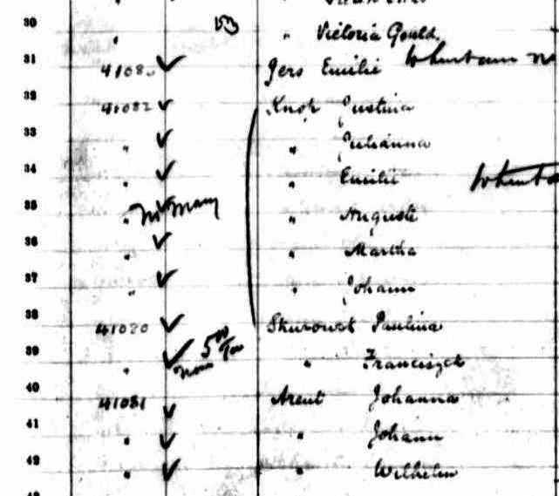
Knop ship manifest 25 June 1904
Justina Knop (Knob)
Age: 38
Estimated Birth Year: abt 1866
Date of Arrival: 25 Jun 1904
Vessel: Lake Manitoba
Arrival: Montreal, Quebec
Departure: Liverpool, England
Destination: Edmonton
Justina, 38
Julianna, 10
Emilie, 7
Auguste, 7
Martha, 2
Johann, 1
Johanna Arent (Arndt)
with children Johann & Wilhelm also going to Edmonton

Slide 29
1916 Strathcona, AB census
1904 Knop ship manifest:
Justina, 38
Julianna, 10
Emilie, 7
Auguste, 7
Martha, 2
Johann, 1
1916 neighbors:
Rhudolph Arndt 46
Johannen Arndt 36
John Arndt 14
Willie Arndt 11
Gustoff Arndt 10
Ernest Arndt 7
Matilda Arndt 2
Townships 49, 50 and 51, ranges 21 and 22, W. 4. M.
Household Members:
Julius Kanopt 46
Jessina Kanopt 40
Julina Kanopt 29
Edward Kanopt 25
Millie Kanopt 20
August Kanopt 19
Martha Kanopt 16
John Kanopt 14
Liddie Kanopt 9
Olna Kanopt 7
Lena Kanopt 5

Slide 30
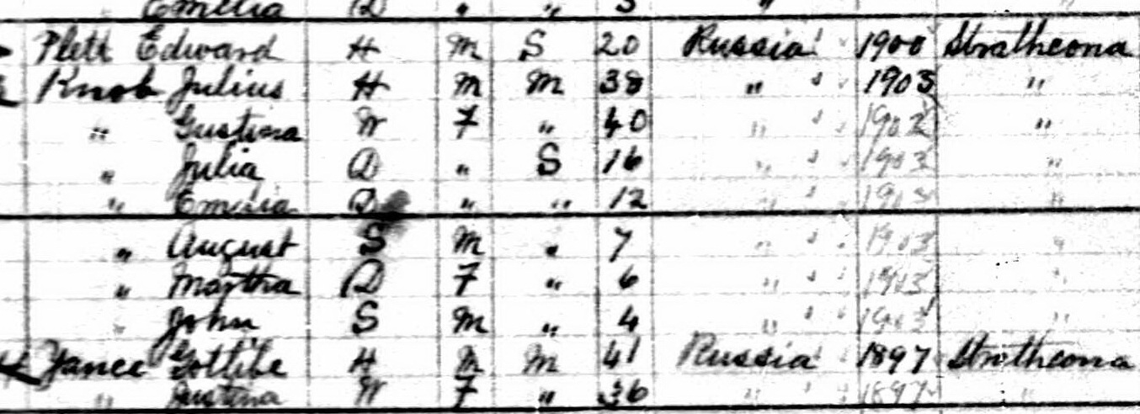
Knob in Strathcona 1906
Notes:
Julius, Justina, Julia, Emilie, August, Martha and John

Slide 31
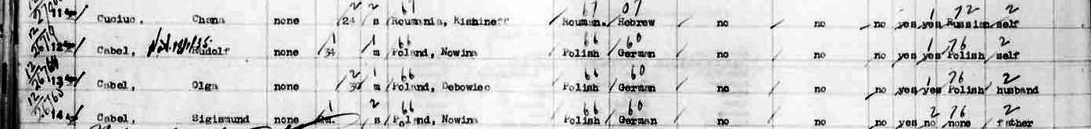
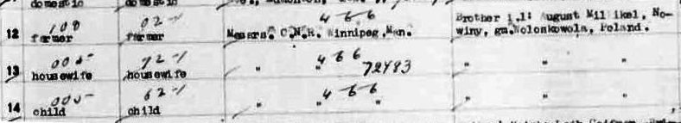
1929 Manifest for Cabel (Zabel)
Rudolf, Olga (Hapke) & Sigismund
Born in Nowina & Debowiec, Poland
Sponsors: C.N.R. Winnipeg
Leaving brother August Milnikel, Nowina
Notes:
Knew they arrived in 1929 & thank Ted Belke for finding them. They lived in Hines Creek for some years, then moved to Edmonton where I visited them in 1955, 1960 and 1968. Who is August Milnikel? Back to Lublin Project database.

Slide 32
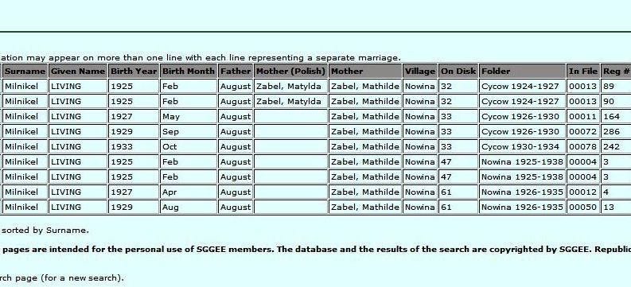
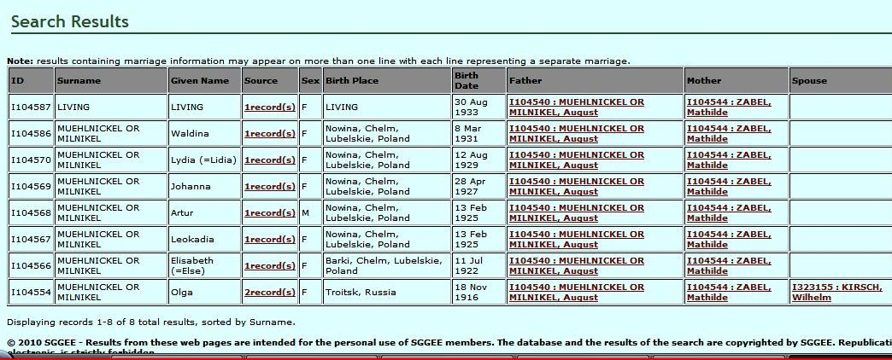
SGGEE searches for Milnikel
Lublin Project database
MPD = EWZ SGGEE008
Notes:
Rudolf Zabel lived in Nowina; he was a cantor there. Mathilde Zabel must be his sister. All new information I wouldn’t have had if I hadn’t asked Ted to find his ship manifest. Bill, could Wilhelm Kirsch be one of yours? What other surprises can ship manifests hold?

Slide 33
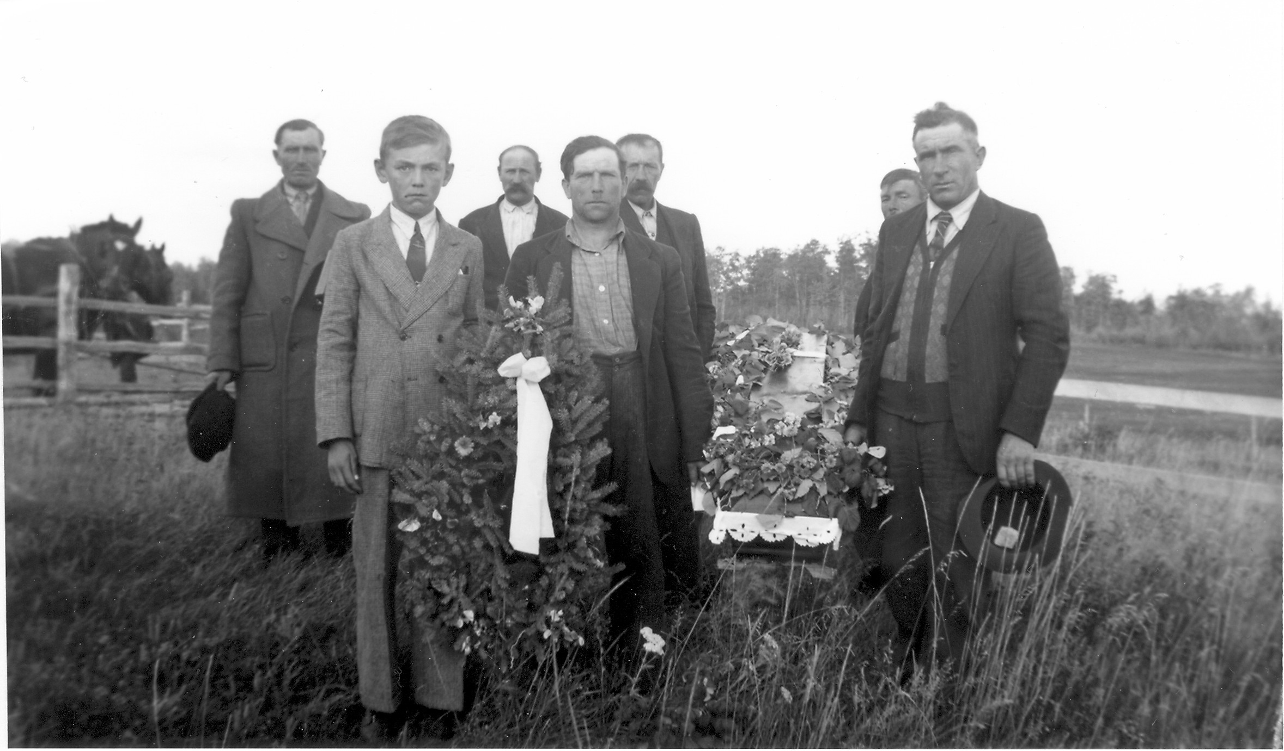
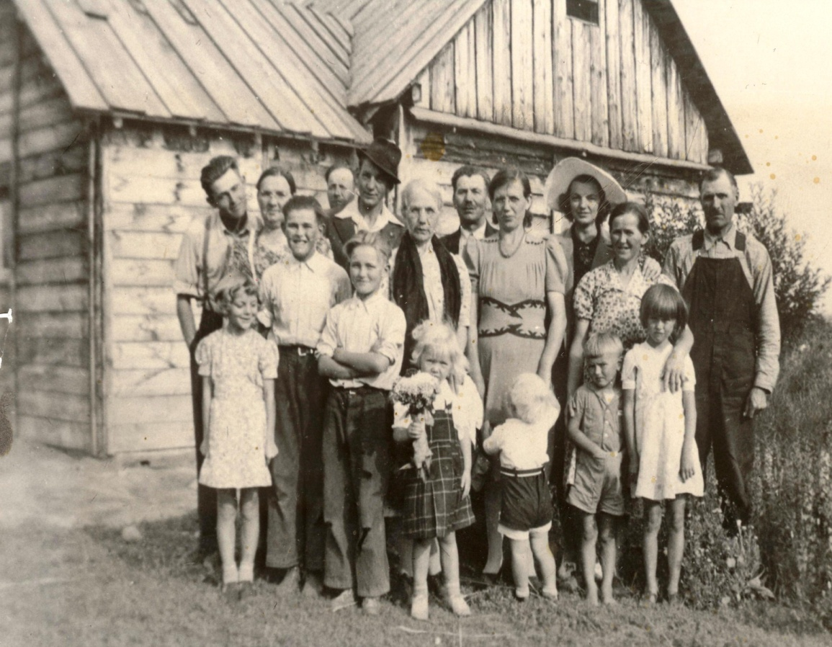
Belke and Zabel in
Hines Creek, Alberta
Belke family in 1942
Sigismund Zabel holding wreath at Adolf Belke’s funeral

Slide 34
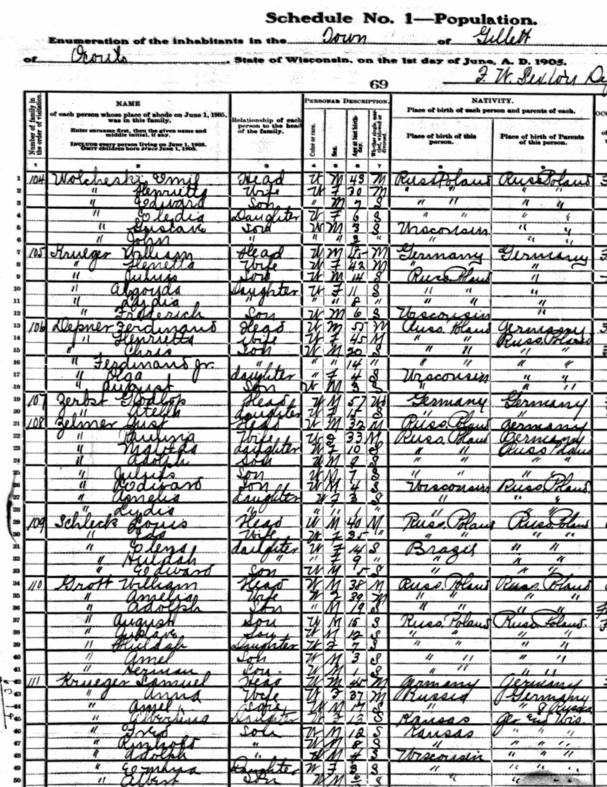
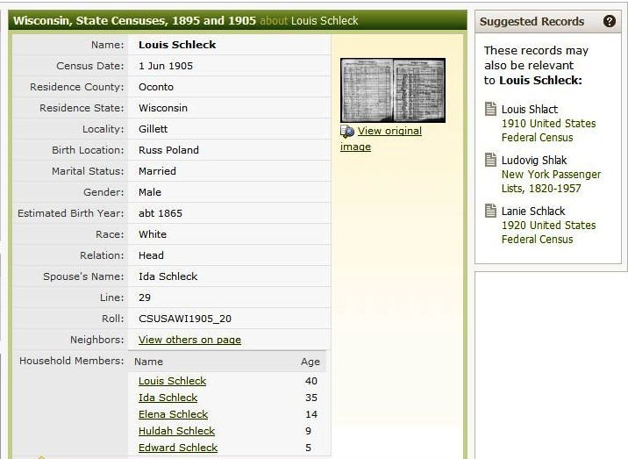
Gillett, Oconto, WI 1905 census
Zelmer, Depner, Krueger, Grott, Zerbst & Schleck
Look for Ludwig Schlak ship manifest
Notes:
Schleck family is not just from Russian Poland and Wisconsin, but from Brazil! And this helped answer a query to the SGGEE email list about this very family who came from the area around Lublin. They had first emigrated to Brazil, then came to Wisconsin.

Slide 35
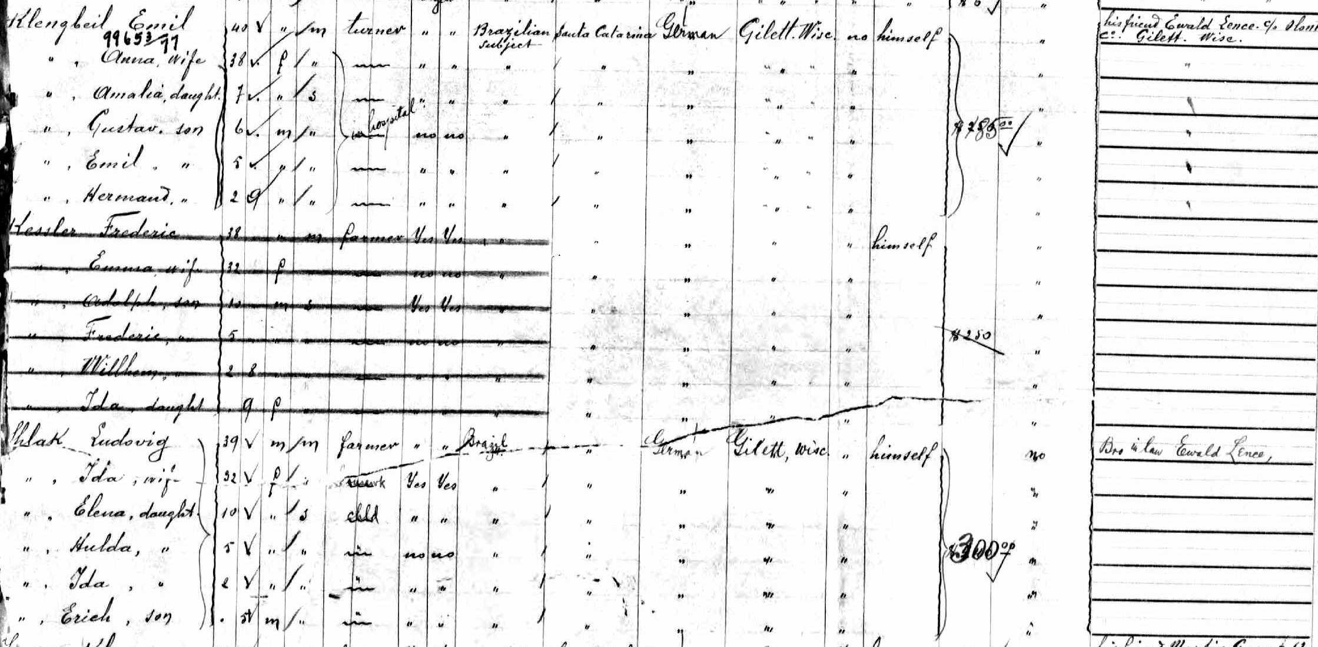
Manifest 23 June 1903 in NY, all going to Gillett, WI:
Emil Klingbeil, Friedrich Kessler & Ludwig Schlak & families going to friend and brother-in-law Ewald Lenz (Lence)
Notes:
Ludwig Schlak married Ida Friederike Kessler; her brother is Friedrich Kessler. A search showed that an Ewald Lentz, born 1878 in Russia, arrived in 1899 and became a naturalized citizen on 24 Sep 1906; passenger manifest: arrived from Kobylki (aka Lanz) with a border crossing to Saskatchewan!

Slide 36
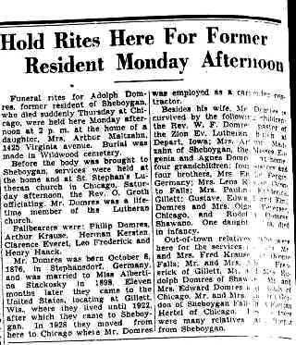
Using Obituaries
Sheboygan Press 11 July 1933
Adolph Domres was father to:
Mrs. Arthur Maltzahn, Sheboygan
St. Stephan’s Lutheran in Chicago
Pallbearers: Philip Domres, Arthur Krause, Herman Kersten, Clarence Everet, Leo Frederick, Henry Haack
Birth: 8 Oct 1876 in Stephansdorf, Germany; m. Albertina Stackosky 1898
To Gillett 1899-1922, Sheboygan, to Chicago in 1928
Survivors: wife, Rev. W.F. Domres at Zion Ev. Lutheran, Iowa; Eugenia & Agnes Domres at home & grandchildren; 4 brothers and four sisters, most local but Mrs. Emilie Fergin in Germany
Out of town relatives etc.

Slide 37
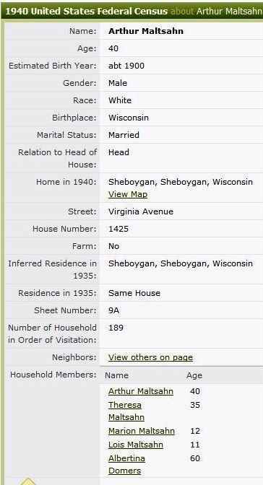
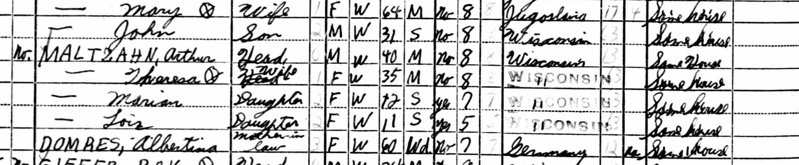
Maltzahn in 1940 census in Sheboygan
Widow Albertina is living with her daughter Theresa in Sheboygan.
Arthur & Theresa have two children: Marion and Lois.
Indexer has spelled Domres as Domers
Maltzahn is Maltsahn but Soundex found it

Slide 38
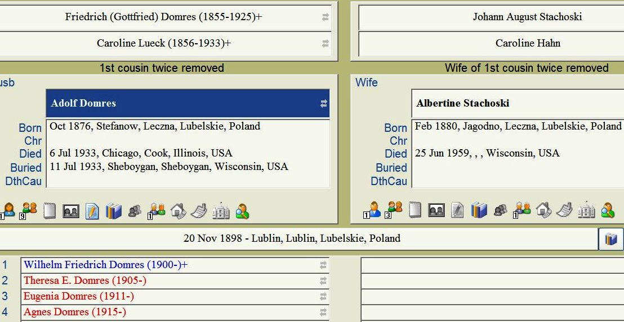
Notes:
Stefansdorf, Germany = Stefanow in Poland; sister Emilie Domres Fergin was living in Poland and died there.

Slide 39
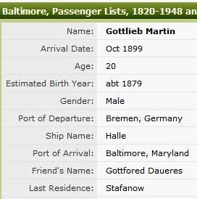
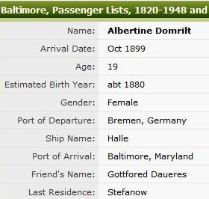
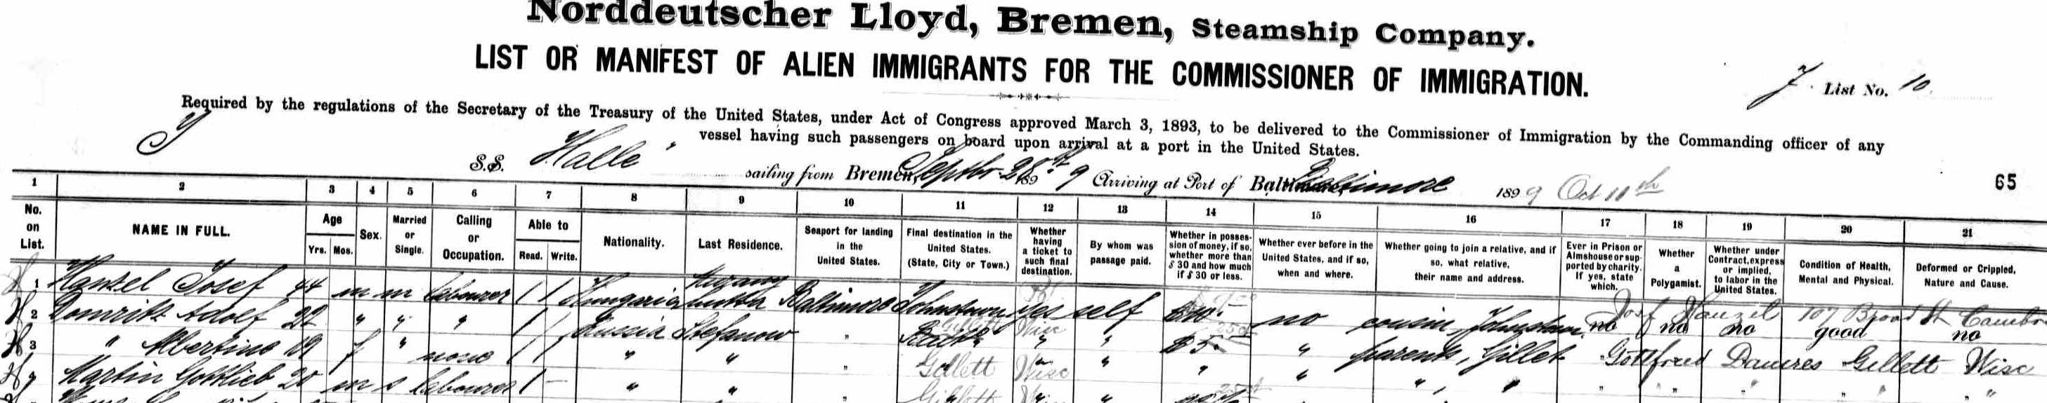
Adolf & Albertine Domres & Gottlieb Martin arrive in Baltimore 11 Oct 1899
Notes:
Gottlieb Martin m. Mathilde Zellmer in 1910; same Zellmer family connected to Domres, Fergin, Friedrich families

Slide 40
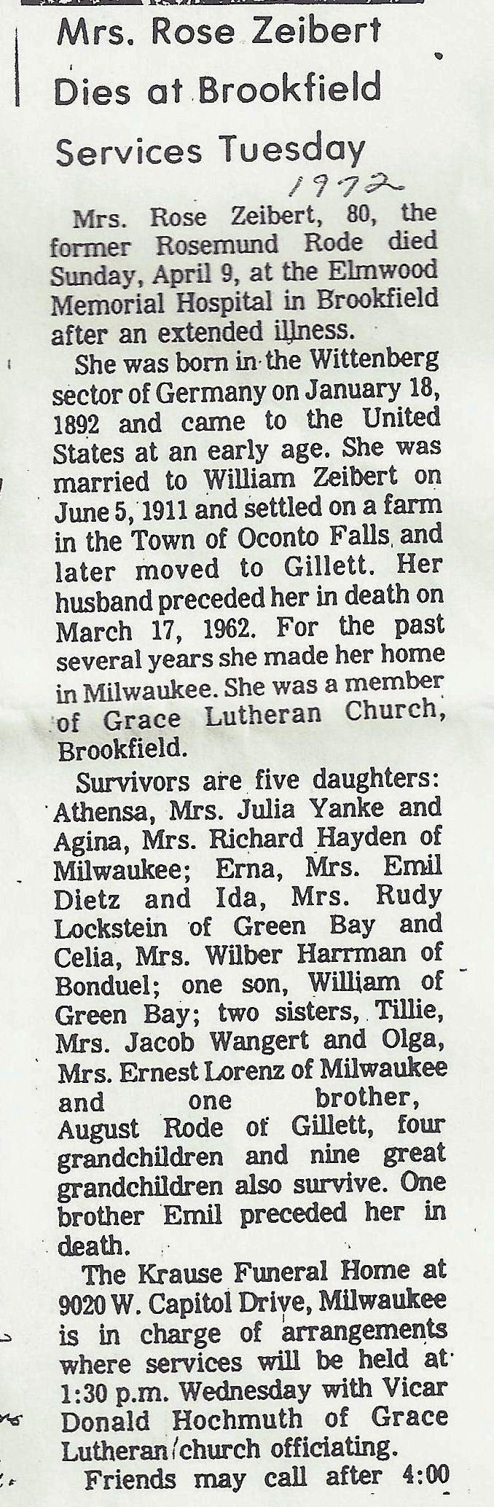
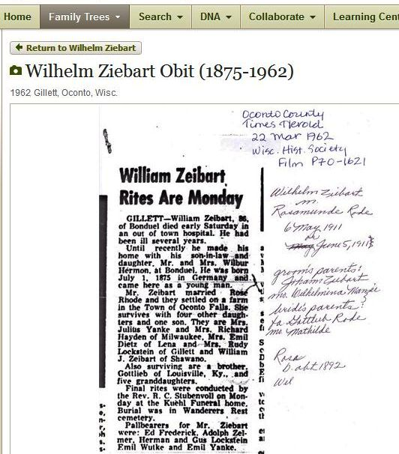
Obituaries & Census Records
William Zeibart
b. 1 July 1875 Germany
m. Rosemund Rode
b. 18 Jan 1892
Wittenberg, Germany
m. 5 June 1911
5 daughters & son
William Zeibart
Athensa (Julius ) Yanke
Agina (Richard) Hayden
Erna (Emil) Dietz
Ida (Rudy) Lockstein
Celia (Wilber) Haarman
Brother:
Gottlieb Ziebart, KY
Rode sisters:
Tillie (Jacob) Wangert
Olga (Ernest) Lorenz
Brothers: August Rode
Emil Rode died
Notes:
Married in 1911, so wouldn’t be in the census until 1920.

Slide 41
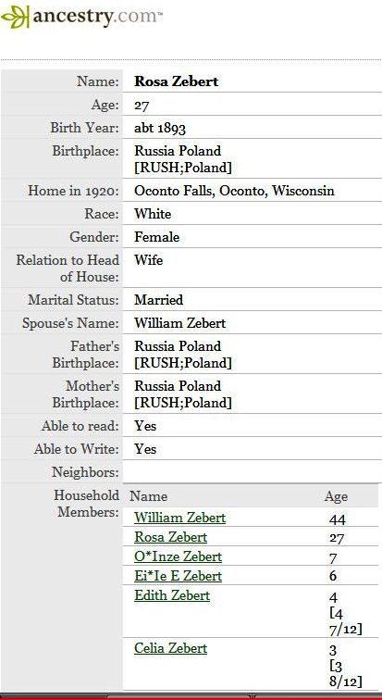
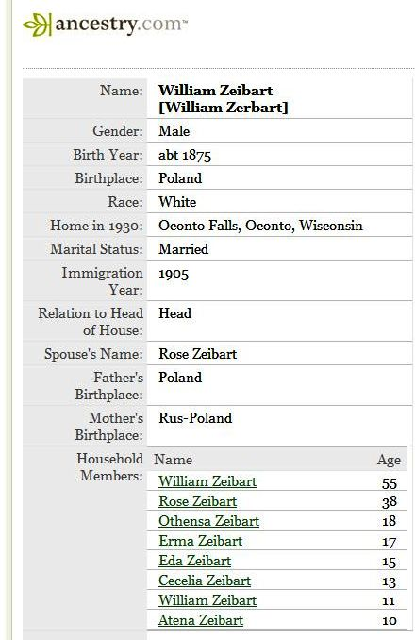
Ziebart in 1920 and 1930 census records
Zeibart/Zebert
Wilhelm Ziebart
b. 1875
Russian Poland
Arrival: 1905
Brother Gottlieb
Rose b. 1892
Russian Poland
NOT Germany for either
Siblings: Rode
Tillie (Ottilie)
Olga
August
Emil

Slide 42
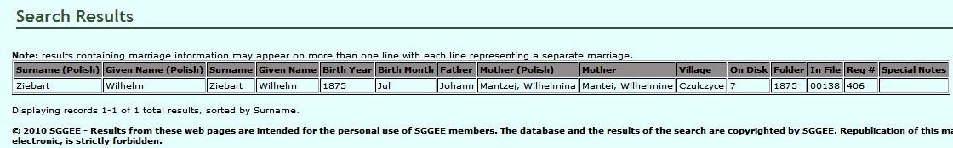
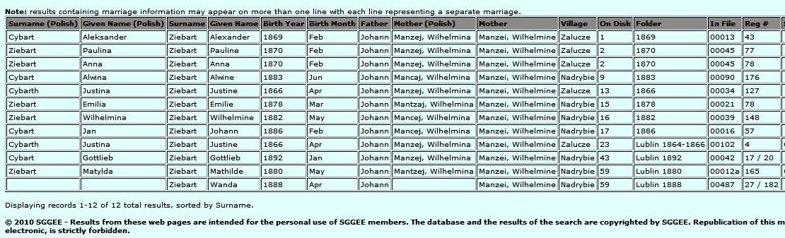
Lublin Project Database search for Ziebart
Notes:
Wilhelm born July 1875 and he has a brother Gottlieb born 1892. Marriage record for Wilhelm & Rose gives their parents’ names.

Slide 43
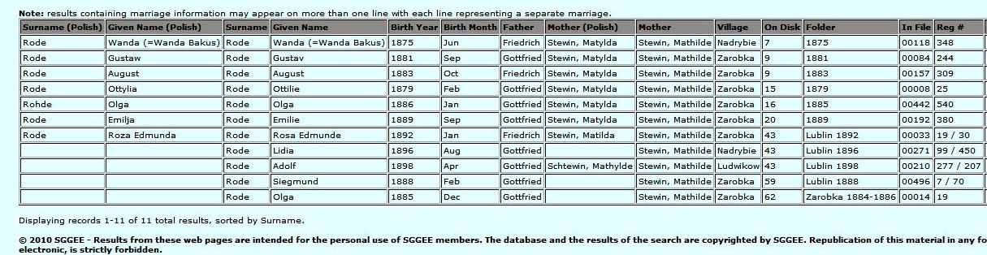
Lublin Project Database search for Rode
Notes:
Rode siblings in US: Ottilie, August, Olga, Rosamunde

Slide 44
Name changes: Are they real?
Spelling errors can result from unfamiliarity with names (ship manifests, census records, etc.); these are temporary and fluctuate with the documents
Legal name changes to conform with pronunciation in the new country or to avoid awkward mispronunciations (example: Janke to Yanke, Tietz to Dietz, Friedrich to Frederick)
Using common nick names: Louis, Fred, Gust, Gussie, Tillie, Minnie, Ophelia, Bill, etc.
Legal name change as a “fresh start” or to avoid discrimination
Compare many records to verify any changes; standardize to German version for easy merging of records in SGGEE

Slide 45
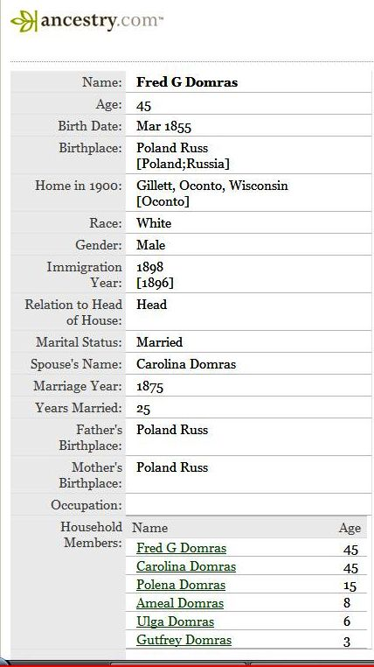
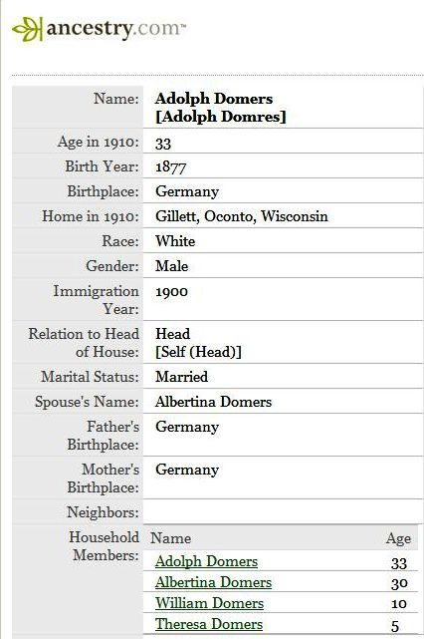
Domres errors: 1900 & 1910
1900
Domras = Domres
Fred G. = Friedrich Gottfried
Carolina
Polena = Paulina
Ameal = Emil
Ulga = Olga
Gutfrey = Gottfried
1910
Domers = Domres
Russian German
1899 Arrival NOT 1900
Adolph
Albertina
William
Theresa
Notes:
The Domers error was perpetuated by the census indexer in 1940; they knew Albertina was Adolph’s wife and spelled her name the same way in the index even though it was correctly written in the record. Notice spellings of names with a literal German pronunciation.

Slide 46
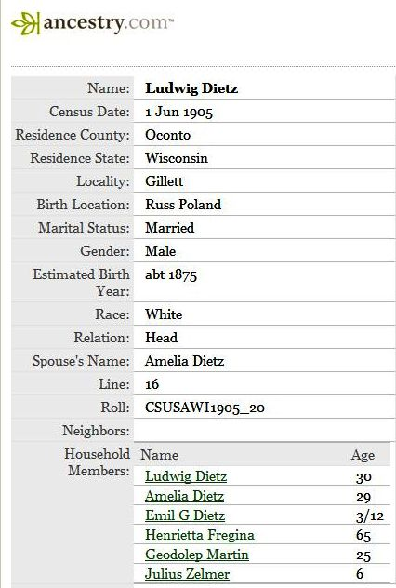
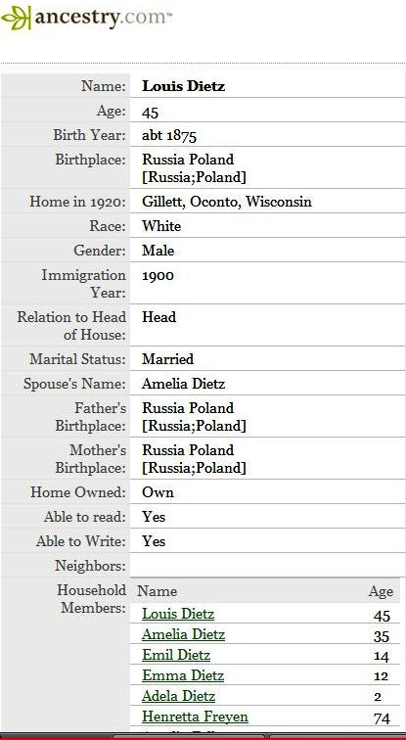
Tietz to Dietz: 1905 and 1920 census
Ludwig Tietz = Louis Dietz
Ludwig m. Emilie Fergin
( aka Amalia Fregin)
Mother:
Henriette (Majewski) Fergin
Gottlieb Martin:
1st cousin to Ludwig
[arrived with Adolf & Albertine
Domres in 1899]
Julius Zelmer is Amalia’s nephew
1910 census shows more Zelmer
kids living with them; their mother, her sister, died in 1909
Henriette is still living with them in 1920

Slide 47


Brother Mikel Tietz from Poland to Wisconsin
& North Dakota to Saskatchewan
Arrived 1896
m. Ottilie Zerbst 1907
in Gillett
[she is also born in the Lublin area]
Move to Kidder, ND by 1920
Move to Saskatchewan before 1930
Ottilie d. in Spokane in 1942
Mikel d. Mellville, SK in 1953
Adult children:
Idaho, Washington,
Saskatchewan

Slide 48

Tracking the Tribe

Slide 49


Oregon
1905 & 1923
Below: Jesse Family
Ludwig, Ottilie (Gurke)
Luise, Natalie, August, Martha
Standing: Carl Wagner, William Lentz, William Zimmerman
Seated: Ottilie Z. Lentz, Jakob Zimmerman, Luise Pusch Zimmerman, Margaret D.G. Z., Teofilia Welke Zimmerman

Slide 50




Illinois to Oregon
1945: Ludwig & Ottilie Jesse
celebrate their Golden Anniversary
1947-1950: Jalosky visit from Chicago
1914 to 1950: mother/daughter pairs
Ophelia Luedke/ Teofilia Welke & Martha Zimmerman/Virginia Jalosky

Slide 51
More to consider:
Multiple marriages: neither men nor women remained widowed long in the 19th century, especially if they had children; 2nd & even 3rd marriages were often within the tribe. Always search indexes for marriages.
Connect with descendents from the same ancestral village in each era; they may know where other members settled. You may find 3rd or 4th cousins! Cousins may have photos and documents common to your family!
Comparing information, documents, stories, photos from other Tribe members may solve mysteries.
Combine search efforts as a team, divide the work & share in the triumphs!

Slide 52


Surprises!
August Hennig m. Emma Scheppe in 1908 & arr. Wisconsin 1913, d. 1929
His wife was deported to Russia in WWI, returned to the Lublin area; she received this photo but had to apply for a death certificate to marry in 1930.
Notes:
Attending August Henning’s funeral: Tucholke, Neumann, Glor, Eckert, Henning, Steinke, Kirsch, Zellmer

Slide 53


New photographs
Olga Wendland Klukas
d. 1 June 1935 in childbirth
Her mother-in-law is my great-aunt, Marianne Pohl who married Gottlieb Klukas
Debowiec group found on website: ca 1938
Ida Dąbrys (Domres), 16 & Herman Pol, 27 & siblings

